Slide 1





















CARAMEL
Coordinators
Project Coordinator
Dr. Pouria Sayyad Khodashenas / Fundació i2CAT
pouria.khodashenas@i2cat.net
Technical Coordinator
Peter Hofmann /
T-Systems International GmbH
p.hofmann@t-systems.com
@amel_project
Social media channels
@caramel_project
Caramel Project
Caramel Project
https://www.h2020caramel.eu/
Project Partners
Artificial Intelligence based cybersecurity for connected and automated vehicles
Project Funded
This project has received funding from the European Union’s Horizon 2020 research and innovation programme under grant agreement No. 833611

Slide 2
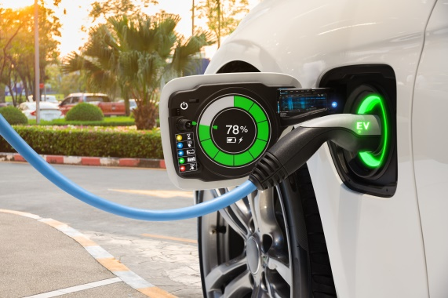
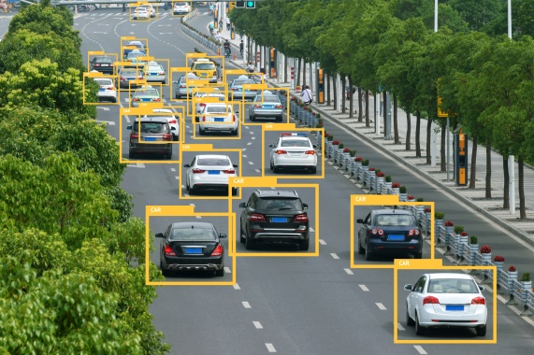

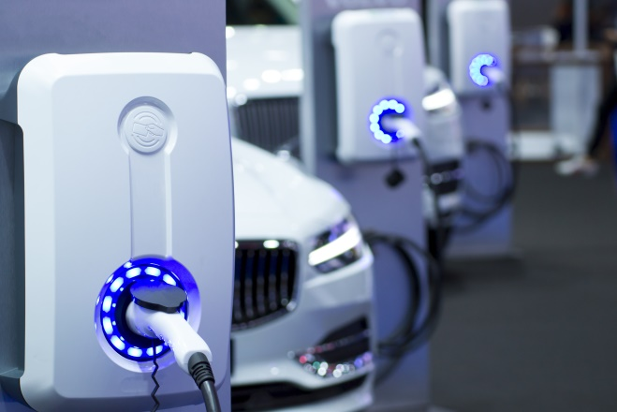
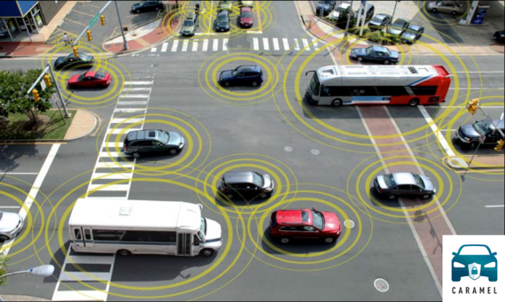
Artificial Intelligence based cybersecurity for connected and automated vehicles
Vehicles are becoming smarter and “greener” through connectivity and artificial intelligence, and cybersecurity is emerging as a new concern able to stop such huge potential for more sustainable safer roads with zero fatality.
GOAL
CARAMEL’s goal is to proactively address modern vehicle cybersecurity challenges applying advanced Artificial Intelligence (AI) and Machine Learning (ML) techniques, and also to continuously seek methods to mitigate associated safety risks.
Electromobility
Unauthorized access and control of EVSE stations and firmware modifications should be prevented.
Considering the entire supply chain, CARAMEL aims to introduce innovative anti-hacking intrusion detection/prevention systems for the European automotive industry.
Challenges
The EU-funded CARAMEL project is developing cybersecurity solutions for the new generation of cars: i) autonomous cars, ii) 5G connected vehicles, and iii) electromobility.
Pilot demonstrations
CARAMEL pilot demonstrations will take place in two premises: at the Test Area in Baden-Württemberg in Germany and at GreenFlux R&D laboratory in the Netherlands where real-world scenarios will be performed with prototype vehicles and smart chargers, under a controlled environment.
Autonomous cars
Cyberattacks do not require physical access to the vehicle or tampering with the communication system.
5G connected vehicles
V2X applications interconnect not only vehicles but also infrastructure and pedestrians, hence it is critical to protect V2X functions from a misuse of such technology.

